Slide 1


Analysis of
Social Buzz's
Content Categories

Slide 2


Today's agenda
Project recap
Problem
The Analytics team
Process
Insights
Summary

Slide 3

Social Buzz is a rapidly growing social media and content creation company.
Accenture is running 3-month initial project to assist them on following tasks.
An audit of their big data practice
Recommendations for a successful IPO
An analysis of their content categories that highlights the top 5 categories with the largest aggregate popularity
Project Recap

Slide 4

Problem
Social Buzz post over 100,000 pieces of content per day.
Social Buzz has over 500 million
active users each month.
What are the top 5 content categories with largest popularity?

Slide 5



Chief Technology Architect
Andrew Fleming
The Analytics team
Senior Principle
Marcus Rompton
Data Analyst
Dulitha Jayakodige

Slide 6
Process
1
Data selecting and understanding
2
Data cleaning
3
Data modeling
4
Data analysis
5
Uncover insights

Slide 7

Insights
16
Content categories
25,000
Reactions
May
Month with highest popularity

Slide 8
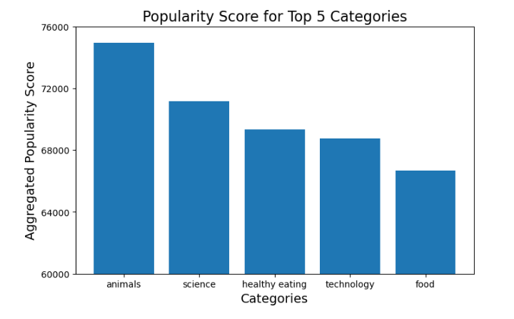

Slide 9
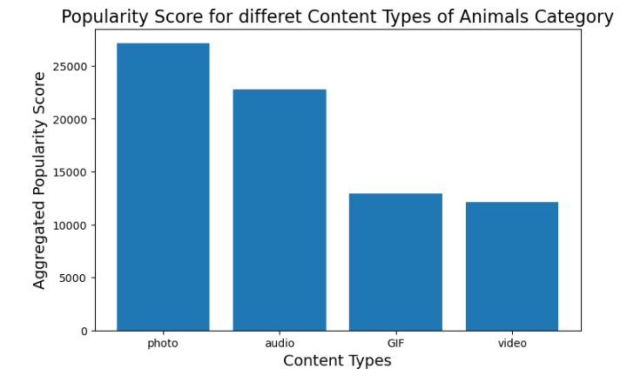

Slide 10

Animals category is the most popular.
Photos are most popular content type in Animals category.
NEXT STEP
This preliminary data analysis provided valuable insights.
Comprehensive analysis is necessary in order to fully understand your business.
Summary

Slide 11
Thank you!
ANY QUESTIONS?

Slide 12
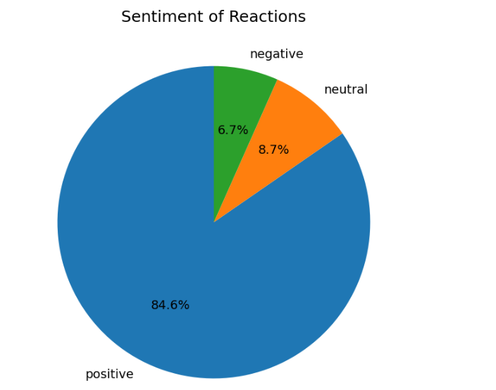

Slide 13
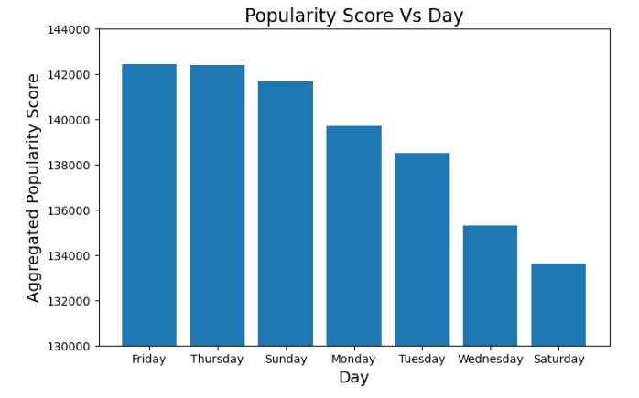

Slide 14
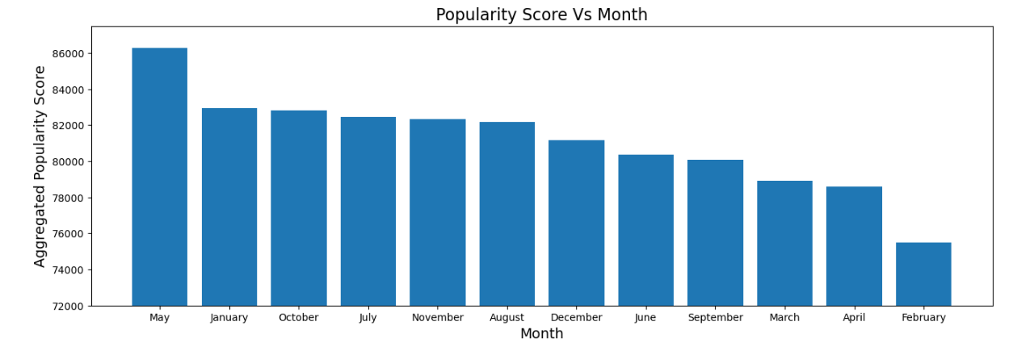

Slide 15
